Slide 1
Florida & Virgin Islands Deaf-Blind Collaborative
Advisory Board Meeting
December 3, 2021
VIRTUAL MEETING

Slide 2
Advisory Board Member updates

Slide 3

Florida DeafBlind Association
FDBA website www.fldeafblind.org
Notes:
2020

Slide 4
FDBA Accomplishments
Official change from SSP (Support Service Provider) to CN (CoNavigator)
FDBA has entered a joint venture with True-Biz ASL Interpreting Services to provide the CN services. FDBA continues to support FCN by providing training for the new CNs and refresher training.
PT ROCKS! - FDBA, HKNC, T-Mobile, and FAVI – joined together for a hands-on ProTactile training weekend
Notes:
2020

Slide 5
Bureau of Exceptional Education and Student Services (BEESS)
Jennifer Coburn
Program Specialist for Deaf/Hard of Hearing, Visual Impairments and Dual-Sensory Impairments
Notes:
2021-Florida Department of Education, Bureau of Exceptional Education and Student Services, Jennifer Coburn, Program Specialist for Deaf/Hard of Hearing, Visual Impairments, and Dual-Sensory Impairments

Slide 6
FAVI Meeting – Florida VR contact info
2021
Florida Department of Education, Division of Vocational Rehabilitation
Deaf, Hard of Hearing, and Deafblind Services (DHHDB) Program
Visit our program at www.rehabworks.org
Program Contacts:
Cory Parker at cory.parker@vr.fldoe.org
Stevie Fenton at stevie.fenton@vr.fldoe.org
Notes:
Upper banner is light blue with dark blue text that reads: FAVI meeting Florida VR contact info
Lower banner shows photos of persons signing, using a motorized wheelchair, using a long cane, and using crutches.

Slide 7
Florida VR logistics
VR’s Deaf, Hard of Hearing, Deafblind Services Program has staff throughout the state.
  At HQ - Program Administrator, a Senior Program Consultant, a Staff Interpreter,
  and a GOC Project position.
  In the field – 5 State staff interpreters and
  11 contracted Staff Interpreters
  (Service Source)
Notes:
Upper banner is light blue with dark blue text that reads: Florida VR logistics
Lower banner shows photos of persons signing, using a motorized wheelchair, using a long cane, and using crutches.

Slide 8
Florida VR HQ program
The HQ Staff works with VR staff statewide
  VR Counselors and Technicians - cases involving Deaf, HH, and Deafblind
  Community of Practice – a select group of DVR and DBS professionals to discuss services, needs, and realities of our DB clients
  VR Leadership and Communications Unit – policies and practices impacting population
  (including ASL Orientation video)
Notes:
Upper banner is light blue with dark blue text that reads: Florida VR logistics
Lower banner shows photos of persons signing, using a motorized wheelchair, using a long cane, and using crutches.

Slide 9
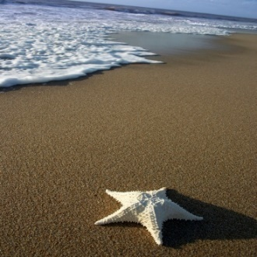
Florida VR Update
  Annually, we serve over 4,000 customers who are Deaf, HH & Deafblind + 1,000 customers (HL as secondary)
  VR is currently in planning stages of the SouthEast Regional Institute on Deafness (SERID) conference in Florida for 2022
Notes:
Upper banner is light blue with dark blue text that reads: Florida VR update
Lower banner shows photos of persons signing, using a motorized wheelchair, using a long cane, and using crutches.

Slide 10
Florida VR DHHDB Collaboration
DHHDB Services maintain contacts with vendor interpreting agencies statewide
  To secure interpreters meeting VR’s high standards and needs of customers who are DB.
VR continues to partner with DBS in serving dual-case Deafblind consumers.
  The DHHDB Services Program team and DBS Administrators meet at least quarterly to discuss joint cases, services, staff training, and issues impacting customers who are DB.
Notes:
Upper banner is light blue with dark blue text that reads: Florida VR DHHDB services
Lower banner shows photos of persons signing, using a motorized wheelchair, using a long cane, and using crutches.

Slide 11
Florida VR DHHDB Collaboration
The DHHDB Services team continues regular contacts with David Volper, HKNC Regional Representative, and HKNC’s soon-to-be-hired Deafblind Specialist.
  HKNC provides consults on DB cases, evaluations/training, and staff training
  HKNC is a VR Vendor to provide employment services to VR customers who are DB
VR continues to collaborate with other state government agencies and community programs to expand services to individuals, including DB.
Notes:
Upper banner is light blue with dark blue text that reads: Florida VR DHHDB collaboration
Lower banner shows photos of persons signing, using a motorized wheelchair, using a long cane, and using crutches.

Slide 12

Lighthouse for the blind and low vision
Lighthouse for the Blind & Low Vision
(Tampa Lighthouse for the Blind)
1106 W. Platt Street, Tampa, FL
206 Avenue D NW, Winter Haven, FL
Our mission is to maximize independence and provide employment opportunities for person who are blind or visually impaired of all ages.
Early Intervention services to children 0-6
Transition/Pre-employment to teens 13-22
Independent Living Training / Assistive Technology Training / Vocational Evaluation / Job Placement and Supported Employment to Adults
Magnifiers and More Store
Notes:
2021-with changes per Sheryl Brown

Slide 13
Lighthouse Updates
Celebrating our 81st year of service
55 employees between two locations
Services returned to face-to-face in August.
Some individuals are still asking for virtual services.
Providing one-to-one job placement and job saves and Orientation and Mobility. The store is open!
Services are provided to individuals who are deaf or hard of hearing through Division of Blind Services and Division of Vocational Rehabilitation.
Staff are certified as CVRT or COMS or CATIS or TVI
Notes:
2021-with changes per Sheryl Brown

Slide 14

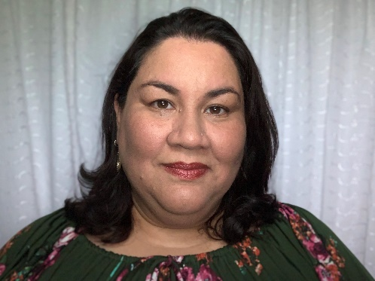

Early steps
Doris Tellado
Family Resource Specialist
University of Florida, Department of Pediatrics, North Central Early Steps,
dtellado@peds.ufl.edu
PO Box 100296 Gainesville, FL 32610
Direct Line: 352.260.4629
Cell: 352.322.0441
Fax 352.294.8088|
Website www.myearlysteps.com
Notes:
2021-by Doris Tellado

Slide 15
Early steps continued
Early Steps Partnership with FAVI Deaf-Blind Collaborative
Family
Parent of a constituent
Webinar series: Maria Bove Futures Planning
Story Time
Family Leadership
F2F Spanish Call
Family Partners for the DeafBlind
of Florida and U.S. Virgin Islands
Florida Family Leaders Network (FFLN)
Notes:
2021-by Doris Tellado

Slide 16
Early steps continued
Early Steps Partnership with FAVI Deaf-Blind Collaborative continued
Community Partnership
Parent Calls with FAVI and FND
Sharing information with Early Steps Family Resource Specialists and State Parent Consultant
Presenting Child Outcomes Summary training for FAVI and other community partners
Notes:
2021-by Doris Tellado

Slide 17

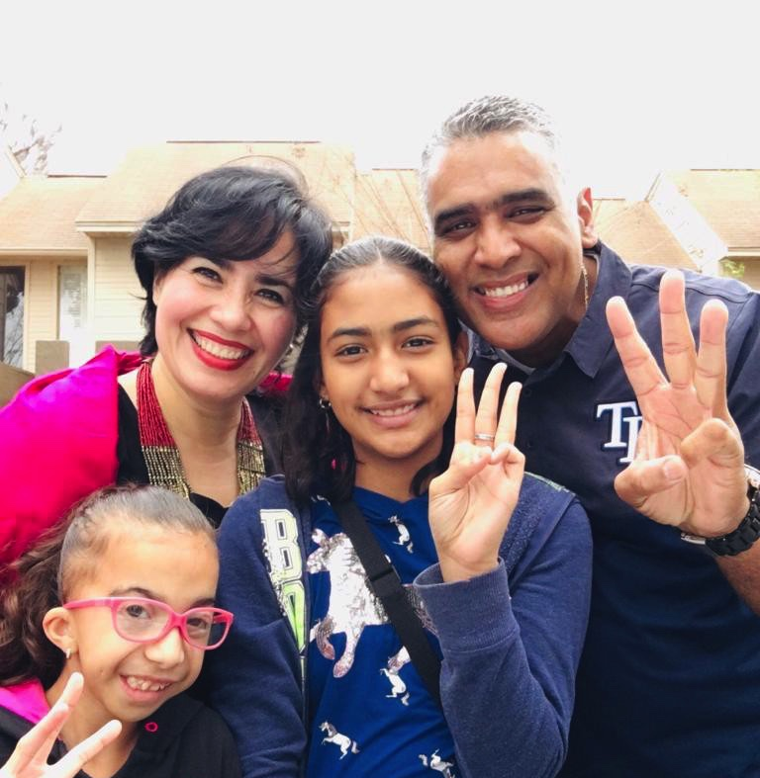
FND
Josefina Gonzalez
Parent training for POPIN (parent offering parent information)
josefinamuro99@gmail.com josefina@fndfl.org
https://fndusa.org/
(352) 362 7634
Notes:
2021-with no changes per Josefina Gonzalez

Slide 18



FND
Family
Parent of a constituent
Story Time
Family Leadership
F2F Spanish Call
Florida Parents for DeafBlind
Attendant FL Family Leaders Network
Collaboration
Parent Calls with FAVI and Early Steps
Wellness Workshops with FND Family Star
Notes:
2021-no changes per Josefina Gonzalez

Slide 19
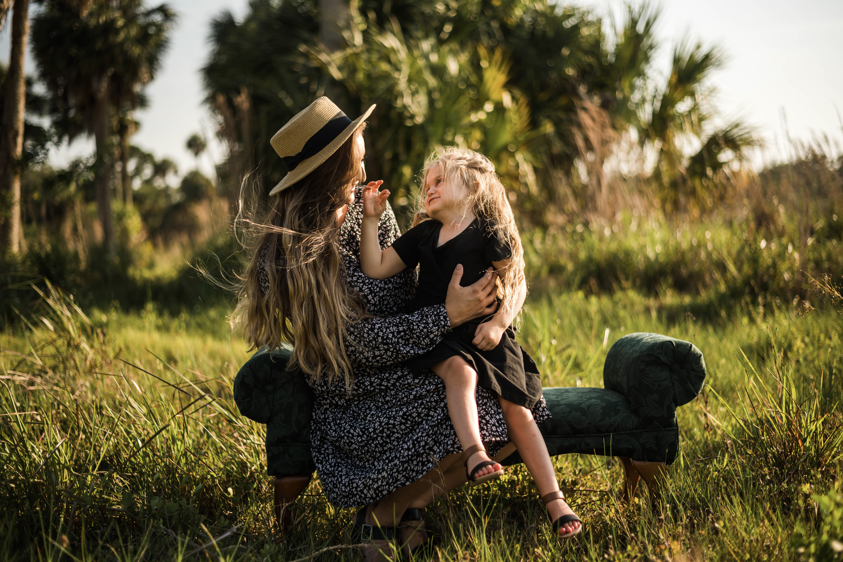
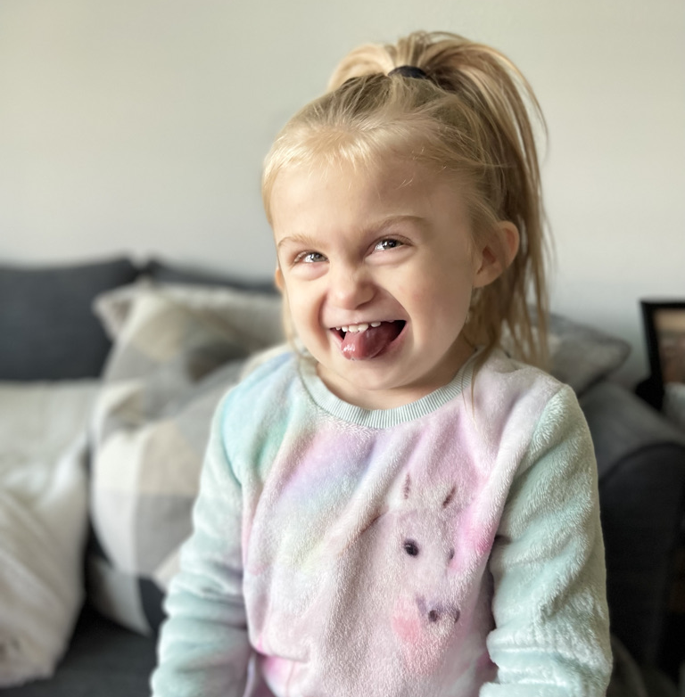
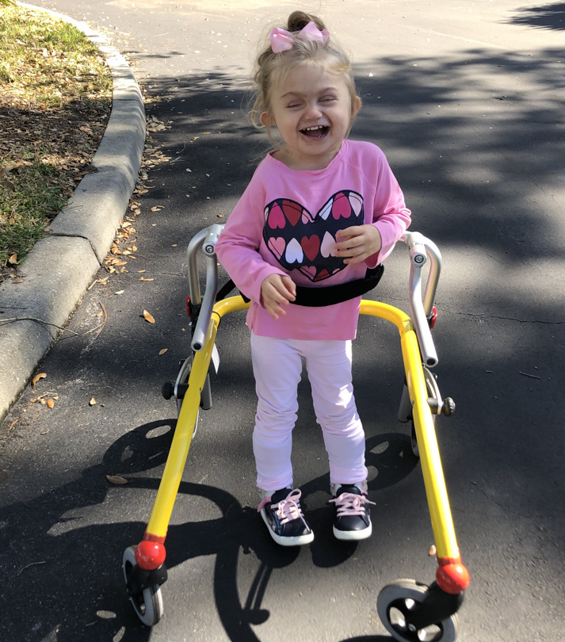
Katrina Michel parent
Katrina Michel
Notes:
2021-per Katrina Michel

Slide 20
Involvements
Parent Representative for the FAVI Deaf-Blind Collaborative
• Co-Chair for the Patient Family Advisory Council of Johns Hopkins All Children’s Hospital
• Florida’s Parent Liaison for the CHARGE Syndrome Foundation

Slide 21
Involvements continued
Leads ’CHARGE Syndrome - Florida Friends!’ Facebook Group
• Co-facilitator for CHARGE families with National Family-to-Family Community Project Group
• Founding member of Family Partners for the DeafBlind of Florida and the US Virgin Islands

Slide 22
Accomplishments
Connected families to the FAVI Deaf-Blind Collaborative
• Voted as Co-Chair/Chair Elect for Johns Hopkins All Children’s Hospital PFAC; taking part in Safety Coaches & Ambulatory Surgery Patient Experience workgroups; joined the Patient- and Family-Centered Care Clinical Community
• Presented on Communication & Moderated/Facilitated in Virtual CHARGE Syndrome Symposium

Slide 23
Accomplishments continued
Joined the NFADB Board, PIE and Outreach Committees, and Social Media workgroup
• Co-Facilitated for NFADB’s 5th Annual DeafBlind Experience
• Met with members of Congress alongside Liliana for the Speak Now for Kids: Family Advocacy Week 2021
• Invited to participate in NFADB’s Family Advocacy Project ‘FATE’ to advocate on the Hill

Slide 24
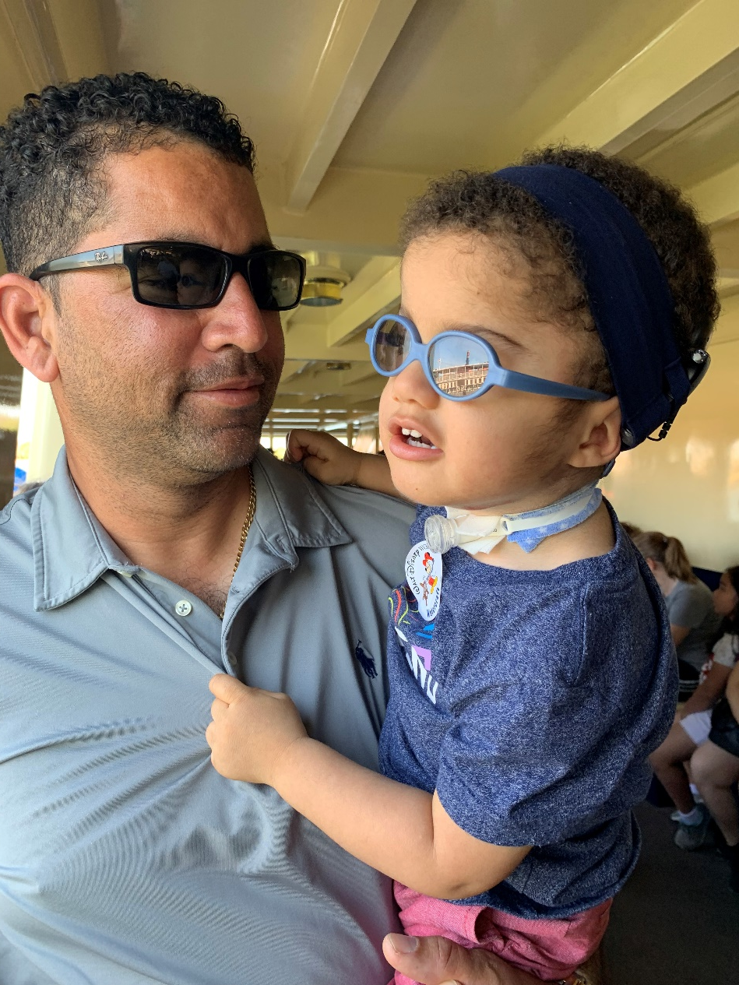
Donia Shirley-Douglas, updates
Notes:
Donia is the parent of Jaxson Douglas and a valuable partner of the FAVI Deaf-blind Collaborative!

Slide 25


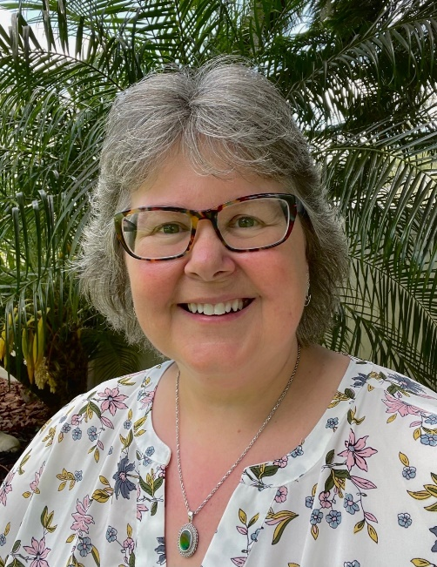
Dr. Liz Perkins PhD RNLD FAAIDD FGSA
Associate Director and Research Associate Professor
Florida Center for Inclusive Communities UCEDD
University of South Florida, Tampa.
-Member, Board of Directors, Disability Rights Florida
- Past President, American Association on Intellectual and Developmental Disabilities.
www.flcic.org
www.inclusionflorida.org
www.ddwaitlistfl.org
Notes:
2021-per Liz Anderson

Slide 26
FCIC Annual Accomplishments
Education/Community Training: 2931 hours to 20,972 participants
Technical assistance: 9895 hours to 7297 participants
Direct services: 49457 to 2,465 people with DD and their families
Research: 4901 hours
Product Dissemination to 451,720
228 products developed this year
15 peer reviewed articles, 11 book chapters and 58 conference presentations
$13.2 million in grants & contracts, across 27 programs and projects
Notes:
2021-This year FCIC performed 2931 hours of training to 20,972 participants. We provided 9895 hours of technical assistance to 7297 people. FCIC direct services were provided to 2465 people, across 49,457 hours. We also engaged in 4901 hours of research activity. FCIC developed 228 new products, and continued dissemination of products developed in previous years. The combined total dissemination of these products reached 451,720 people with DD, family members, and professionals. Combined total of $13.2 million in grants and contracts across 27 programs and projects.

Slide 27
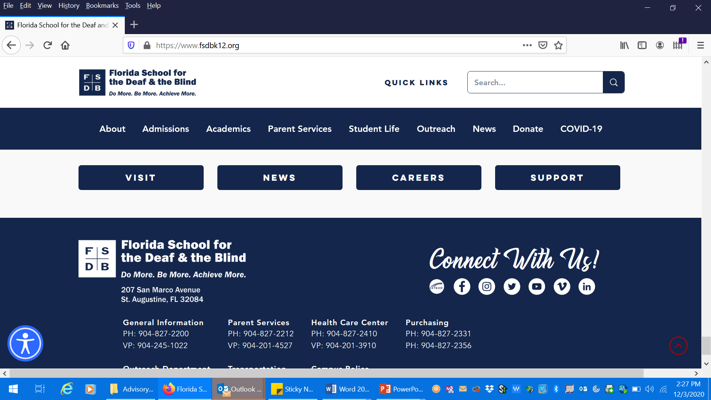
Florida School for the Deaf and the Blind
207 San Marco Avenue
St. Augustine, Florida 32084
John Baroncelli “JB”
DSI Services Coordinator
E: baroncellij@fsdbk12.org
P: 904.429.1441
General Information
PH: 904-827-2200
VP: 904-245-1022
Outreach Department
PH: 904-827-2455
Parent Services
PH: 904-827-2212
VP: 904.201.4527
Notes:
2021-no changes per John Baroncelli

Slide 28
Florida School for the Deaf and the Blind activities
Perform annual Deaf 6th graders- Usher Syndrome Screenings.
Mail/Email USH screening results to Parents/Guardians.
Perform classroom observations on Dual Sensory Loss students to monitor accessibility needs, classroom improvements and recommendations for their IEP’s.
Classroom observation can occur 2-4 times per school year, based on students needs.
Notes:
2021-no changes per JB

Slide 29
Florida School for the Deaf and the Blind activities cont.
Collaborate with the Blind Dept, to observe FVLMA on DSL students. Also to retrieve updated Low Vision Clinic reports on DSL students.
Provide advocacies/supports to DSL students, especially in their teens.
Provide supports to our Career Technical Team on Pre-ETS.
Contact DSL student’s families and inform of available outside agency/providers/vendors for continued support prior to graduation.

Slide 30

www.fimcvi.org (on FB, Twitter, YT)
Providing Accessible Instructional Materials and Assessments
1
Professional Development Opportunities
2
Managing Federal Quota Program from American Printing House for the Blind
3
Student Events such as Braille Challenge and Cane Quest®
4
Loan Library – Specialized Technology and Materials
5
Notes:
2021-by Liz Anderson

Slide 31
FIMC-VI Updates
Launched first prison braille program in Florida
New Online Module: What to Do if You are Working with a Student Who is Blind or Visually Impaired
Canvas site to support those interested in learning UEB Math/Science
Several new archived webinars
  Providing Inservices to Classroom Teachers; Initial Eligibility and Reevaluation
Notes:
2021-by Liz Anderson

Slide 32
FIMC-VI Updates continued
2022 Florida Regional Braille Challenge scheduled to be face-to-face
Spring Working with the Experts: Augmentative and Alternative Communication: Unique Considerations for Students with Visual Impairments
  Virtually April 21, 2022
  Registration will be added to our Events page

Slide 33

Educational Interpreter Project
Free Statewide Resources and Services
  Aaron Izzo, Director
  aaizzo@pasco.k12.fl.us
Jennifer Francisco, Coordinator,
Ed Certifications: K-6 and HI, Master’s in Reading Education
jfrancis@pasco.k12.fl.us
727-210-7150
http://www.pasco.k12.fl.us/interpreter
Notes:
2020-with no changes per Aaron Izzo

Slide 34
Educational Interpreter Project performance assessments
Educational Interpreter Performance Assessment (EIPA)
Financial Assistance to Interpreters:
  College Tuition Reimbursement
  National Testing Stipends
    EIPA and NIC
Mentoring Opportunities
Notes:
2020-with no changes per Aaron Izzo

Slide 35
Educational Interpreter Project professional development
  Professional Day and Saturday Workshops
    Available Throughout the Academic Year
    Online Professional Development Opportunities (CEUs on the Go)
    Summer Institute-4 days of training
Notes:
2020-with no changes per Aaron Izzo

Slide 36
Educational Interpreter Project technical assistance
  Best Practices Support (District and Staff)
  IEP Development Assistance
  Student/Interpreter Evaluations and Observations
  Books and DVDs available
Link to sign up for mailing list: https://ryu.pasco.k12.fl.us/do-mform/view.php?id=103533
Notes:
2020-with no changes per Aaron Izzo

Slide 37
National Center on Deaf-Blindness (NCDB) and State Deaf-Blind Project
Technical Assistance (TA)
NCDB at Work
Michael Fagbemi, Transition Initiative Lead
Notes:
2021-link to NCDB at Work flyer added

Slide 38
NCDB Initiative Areas
Early Identification and Intervention
Family Engagement
Interveners & Qualified Personnel
Transition to Adult Life
Other important focus:
Maintaining a National Child Count
Peer-Learning Communities
Notes:
2021-link to Peer-Learning Communities added per Mike Fagbemi:
State deaf-blind project personnel work collectively to improve the lives of children who are deaf-blind and their families by:
Sharing knowledge and expertise
Working together to solve problems
Collaborating to provide services
To make this type of networking across state lines as easy as possible, NCDB offers peer-learning communities (PLCs). They are primarily for state deaf-blind projects but depending on the group may include representatives from other national entities. www.nationaldb.org/for-state-deaf-blind-projects/support-from-ncdb/plc/

Slide 39
Transitioning to Adult Life - resources
Transition Resources for Students Who Are Deaf-Blind
NCDB’s Transition Initiative is partnering with state deaf-blind projects and other agencies to address transition using The Recommendations to Improve Transition Outcomes for Students with Deaf-Blindness and Additional Disabilities,
Notes:
2020-Megan

Slide 40
Transitioning to Adult Life
The READY Tool: Readiness Evaluation of Transition to Adulthood for Deaf-Blind Youth – guidance for families and transition teams of individuals aged 14 to 26
Transition and Adult Life Success Stories – the most recent is His Best Life: A Young Man’s Transition to Adulthood
Notes:
2020

Slide 41
NCDB Resources for COVID-19
Resources for Providing TA During the COVID-19 Pandemic
Key Topics for Families
Activities to do at Home
NCDB Professional Development Series: Deaf-Blind Strategies
  Webinar: Establishing Routines at Home
Purpose: To provide a framework for working with families during COVID-19 that supports home based routines and learning for children who are deaf-blind
Notes:
2020-Megan

Slide 42


Dicapta accessible communication developers
https://www.dicapta.com
https://dicaptafoundation.org
Maria Victoria Diaz - mvdiaz@dicapta.com
Olga Collazos - ocollazos@dicaptafoundation.org
Notes:
2021-per Olga

Slide 43
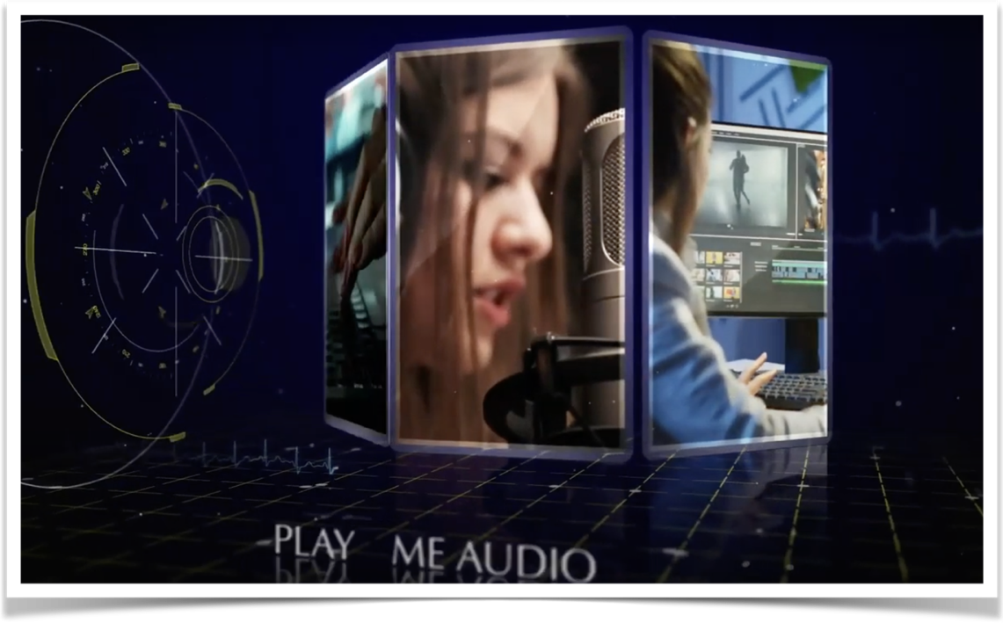
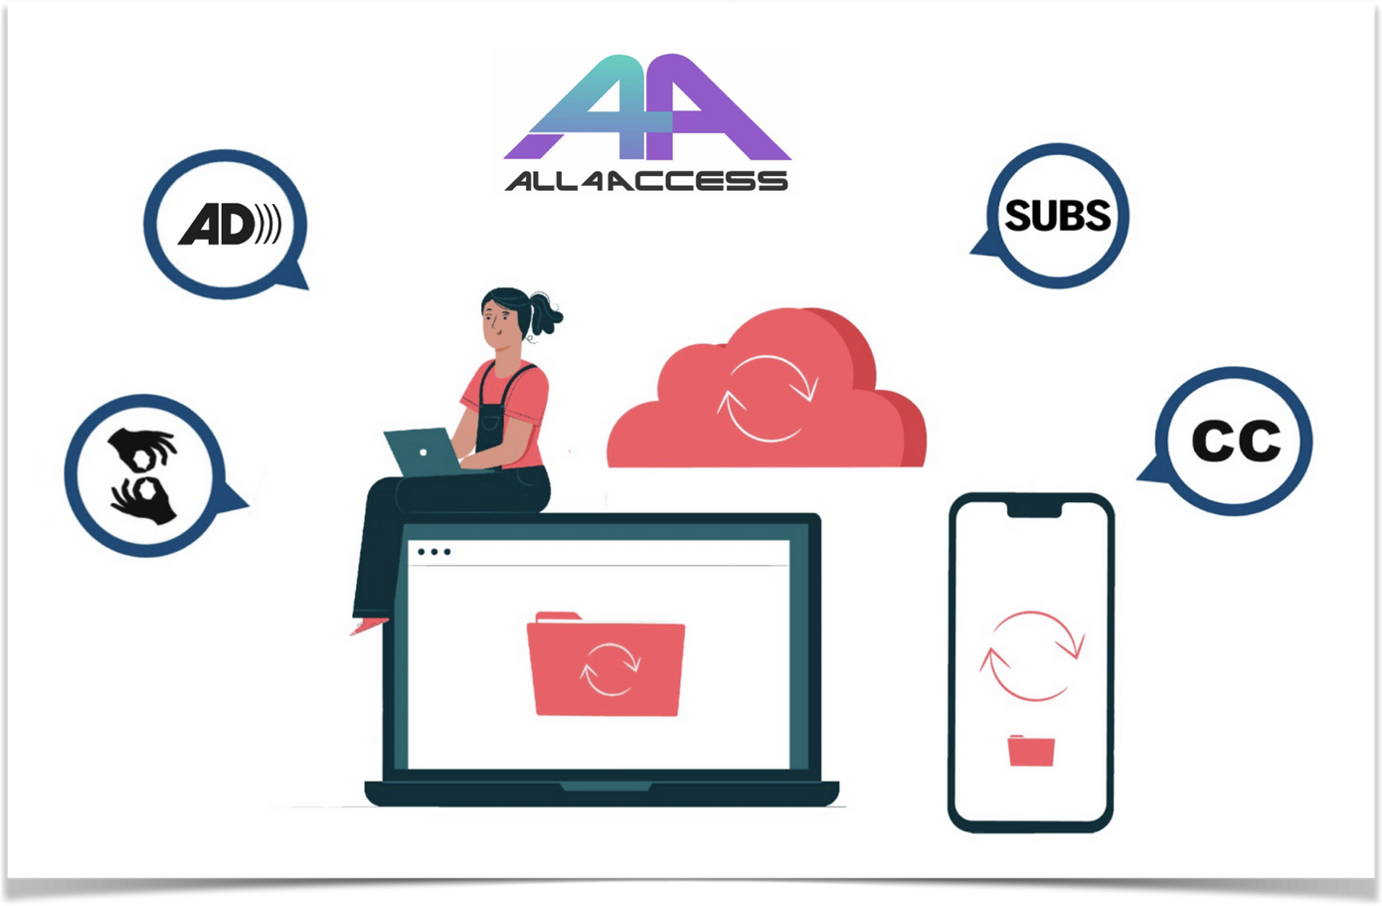
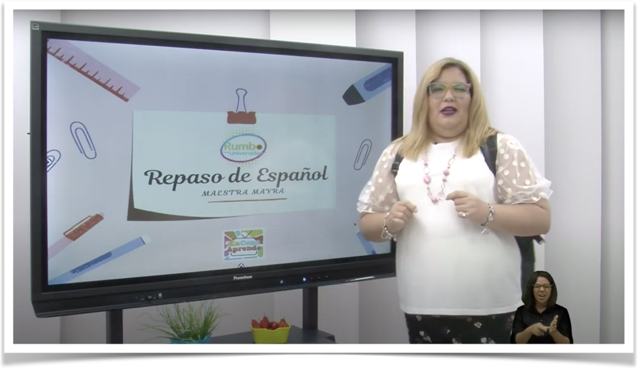
Dicapta accessible communication developers
                OSEP TVAccess Project
                New 5-y cycle - Emerging technology 4 Access
                All4Access - Effortless Universal Access
Notes:
2021-NEW Go CC4All: We were awarded a three-year grant from the National Institute on Disability, Independent Living, and Rehabilitation Research to support the development of this project which is designed to: Provide pervasive technologies bringing television and emergency information to this community.

Slide 44
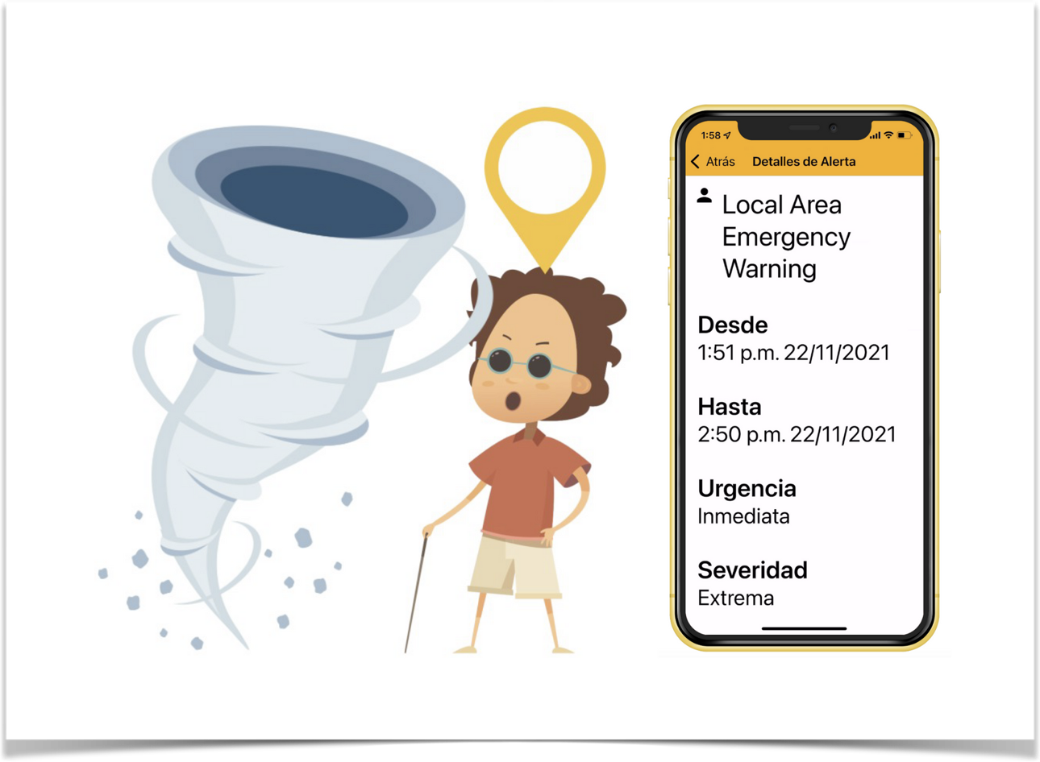

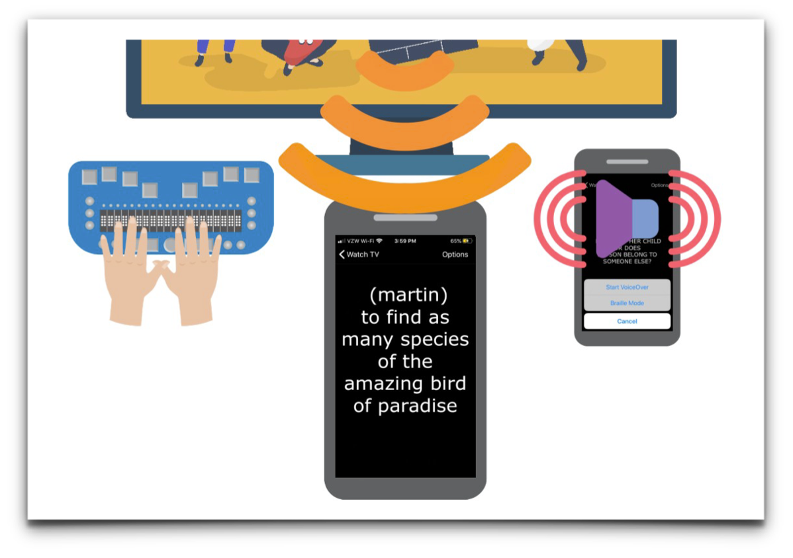
Dicapta accessible communication developers
GoCC4All - Emergency Info & Live TV CC at your Fingertips
Now Spanish alerts also available
https://gocc4all.dicaptafoundation.org
Notes:
2021-per Olga

Slide 45

Helen Keller National Center (HKNC)
HKNC Programs and Services: https://www.helenkeller.org/hknc
Notes:
2021-per David Volper

Slide 46

HKNC Updates
HKNC Programs and Services: On-Campus, Virtual, Hybrid
Professional Learning Courses
HKNC Leadership Updates
The role of the HKNC Regional Representative
Notes:
2021-per David Volper

Slide 47
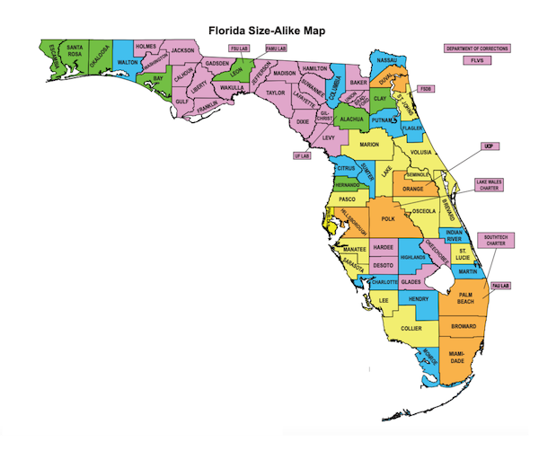


RMTC-D/HH
Resource Materials and Technology Center for the Deaf Hard of Hearing
FL DOE Discretionary Grant Services and Materials from RMTC-D/HH are provided by request and at no charge
RMTC-D/HH
207 San Marco Ave
St. Augustine, FL 32084
800-356-6731
https://www.rmtcdhh.org/
Notes:
2021

Slide 48
RMTC-D/HH is a statewide resource center
Providing:
Professional Development
On-Site Observation & Consultation
On-Site Training & Technical Assistance
Evaluations/Assessments
Information & Referral
Free-Loan Media & Materials Library
  Captioned and Signed Videos for Students and Staff
  Professional Development Resources and Materials
Resources! Resources! Resources!
Notes:
2021

Slide 49
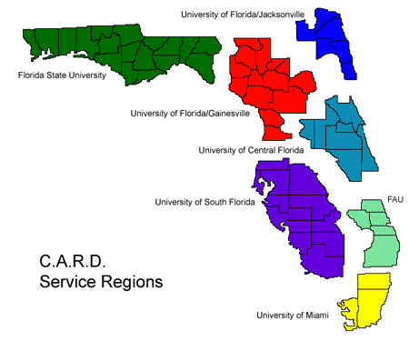
Center for Autism & Related Disabilities
http://www.florida-card.org/
http://card.ufl.edu/
http://www.facebook.com/UFCARD
Notes:
2021

Slide 50

UF CARD Update
As of 9/30/2021, we have 5,371 constituents registered within our 14-county catchment area
For Q1, FY 2021
  1,420 - Individual assistance contacts to registered children, adults, and families
  1,011 - Technical assistance contacts to 1,601 individuals in our area
  114 - Electronic communications to keep our constituents informed via social media and enewsletters
Notes:
2021

Slide 51
UF CARD Update continued
  54 - Local, regional, and online general overview presentations and workshops to 846 individuals.
  11 - Autism/disability awareness events co-sponsored and/or participated in to enhance public education through the dissemination of literature on ASD and CARD services.
  2 – CARD staff members moved away
  1 – New member has joined our staff
Coming up
  29th Annual Statewide CARD conference January - https://cardconference.info/

Slide 52
Project 10: Transition Education Network www.project10.info
4 Major Initiatives
4 Main Indicators
Capacity Building
Interagency Collaboration
Transition Legislation & Policy
Student Development & Outcomes
Indicator 1 – Graduation Rate
Indicator 2 – Dropout Rate
Indicator 13 – Transition IEP Compliance
Indicator 14 – Post School Outcomes
Trainings & Publications Page: http://project10.info/TrainingPublications.php#NS104
Notes:
2021-project 10 transition education network

Slide 53
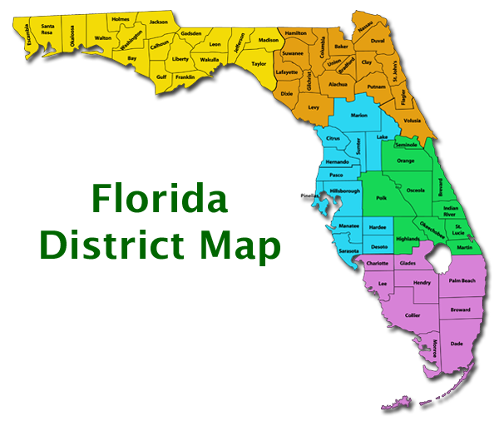
Regional Transition Representatives RTRs
Yellow: Tracy Dempsey (1)
tracydempsey@usf.edu
Orange: vacant
Green: Franklin Coker (3)
fjcoker@usf.edu
Blue: Federico Valadez (4)
fvaladez@usf.edu
Purple: Lisa Friedman-Chavez (5)
Lfchavez@usf.edu
Project 10 Leadership:
Dr. L. Danie Roberths-Dahm
Lroberts@usf.edu
Dr. Donna Phillips
  dphillips@usf.edu
Notes:
2021-project 10 transition education network

Slide 54



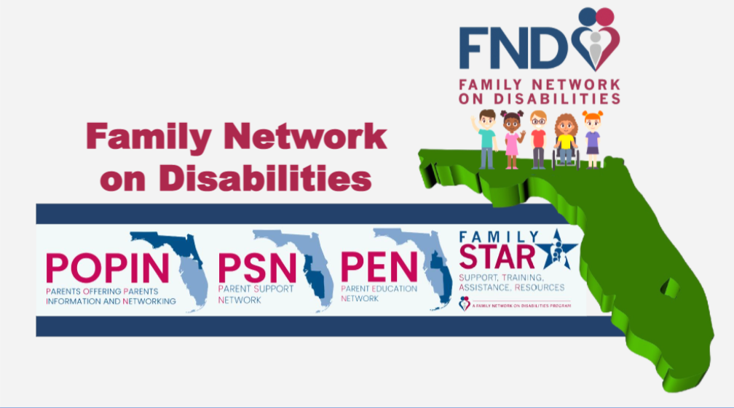

Family netowk on disabilities
Increase collaboration for 2022-2023
Outcomes from Dadvocates
Region Changes for state PTI's
Family Star: partnered with FAVI and FND for their support groups
Notes:
2021-per Tosha Littles

Slide 55

FSDB Parent infant program
Florida School for the Deaf and the Blind
207 N. San Marco Avenue, St. Augustine FL 32084
904 827-2200
Florida School for the Deaf and the Blind official site -
Florida School for the Deaf and the Blind (fsdbk12.org)
Parent Infant Program Facebook - www.facebook.com/fsdbpip/
Notes:
2021-Florida School for the Deaf and the Blind logo shows a navy blue square with white crossed lines in the center and the letters F S D B arranged clockwise from the top left

Slide 56
Early Intervention and Education
An Outreach Initiative providing off- campus support services
  Separate from on-campus programs and eligibility criteria
Serves children ages 0-6 with an established or suspected sensory loss
Available in all FL counites for parents of children with a hearing difference
Available in 27 Counties for parents of children with vision concerns
Notes:
2021-Florida School for the Deaf and the Blind logo shows a navy blue square with white crossed lines in the center and the letters F S D B arranged clockwise from the top left

Slide 57
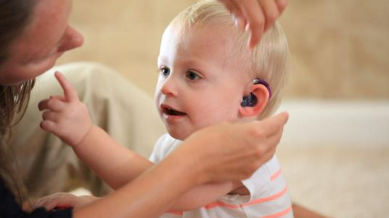
PARENT INFANT PROGRAM- Deaf/Hard of Hearing
Multi- Faceted Support
Notes:
2021-photo of a young child wearing a hearing aid and reaching for a woman’s face is labeled: Parent infant program-Deaf/Hard of hearing multi-faceted support

Slide 58
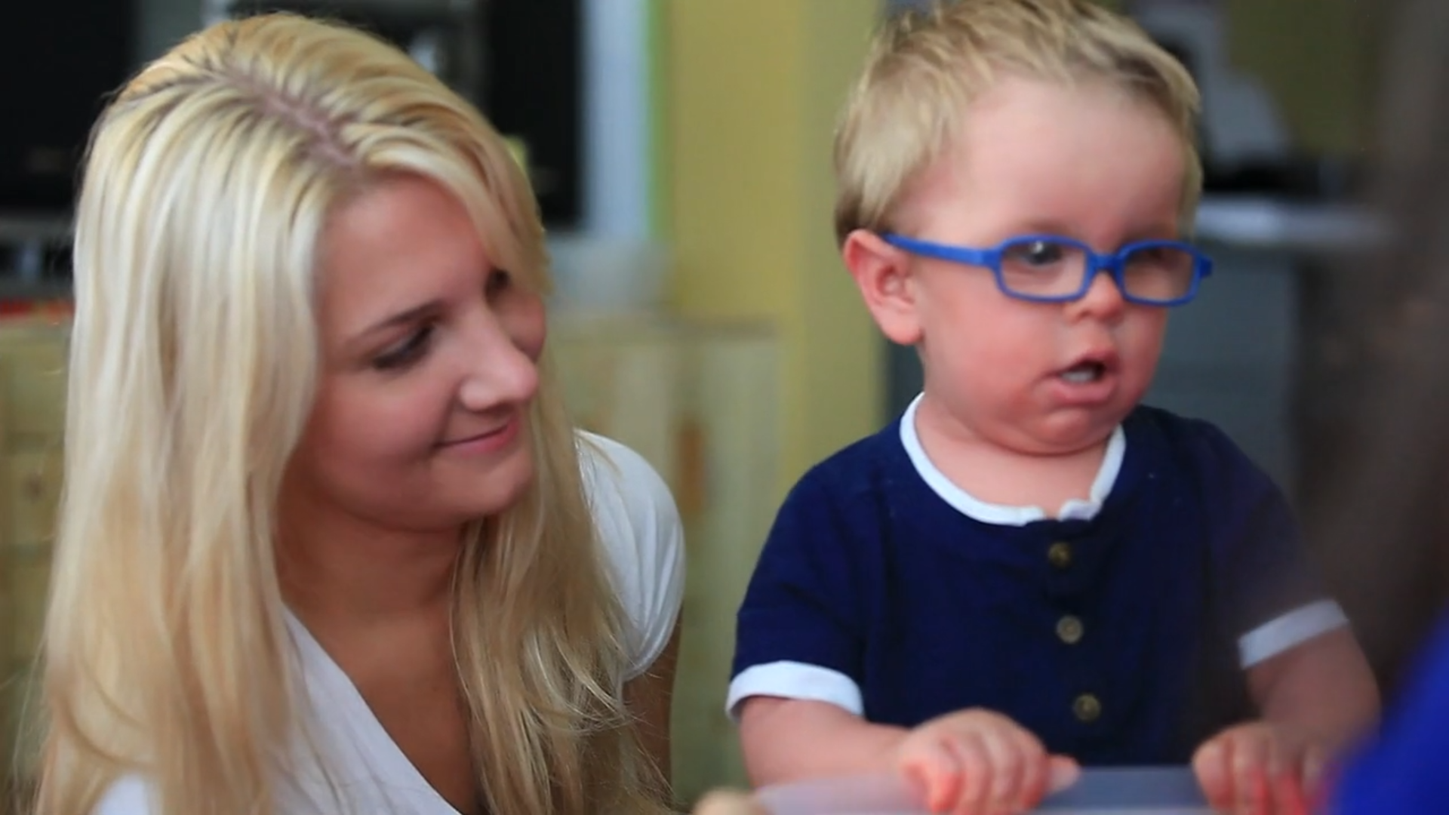
PARENT INFANT PROGRAM- Blind/Visually Impaired
Multi- Faceted Support
Notes:
2021-photo of a young child wearing glasses and standing next to a smiling woman is labeled: Parent infant program-Blind/Visually impaired multi-faceted support

Slide 59
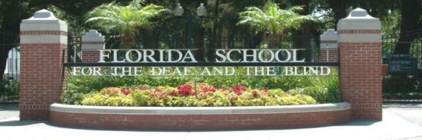
Reach Out to Us:
          Kim Carr, Director
          Program for Blind/Visually-Impaired
          Phone: 904.827.2232
          Email: carrk@fsdbk12.org
          Jennifer Cato, Director
          Program for
          Deaf-Hard-of-Hearing
          Phone: 904.827-2437
          Email: catoj@fsdbk12.org
Notes:
2021-Florida School for the Deaf and the Blind logo shows a navy blue square with white crossed lines in the center and the letters F S D B arranged clockwise from the top left

Slide 60

Virgin Islands Division of Special Education
Sheryl Serano-Griffith
District Director
Ms. Morina Lamb
Teacher of the Visually impaired who works with children Territory wide.

Slide 61
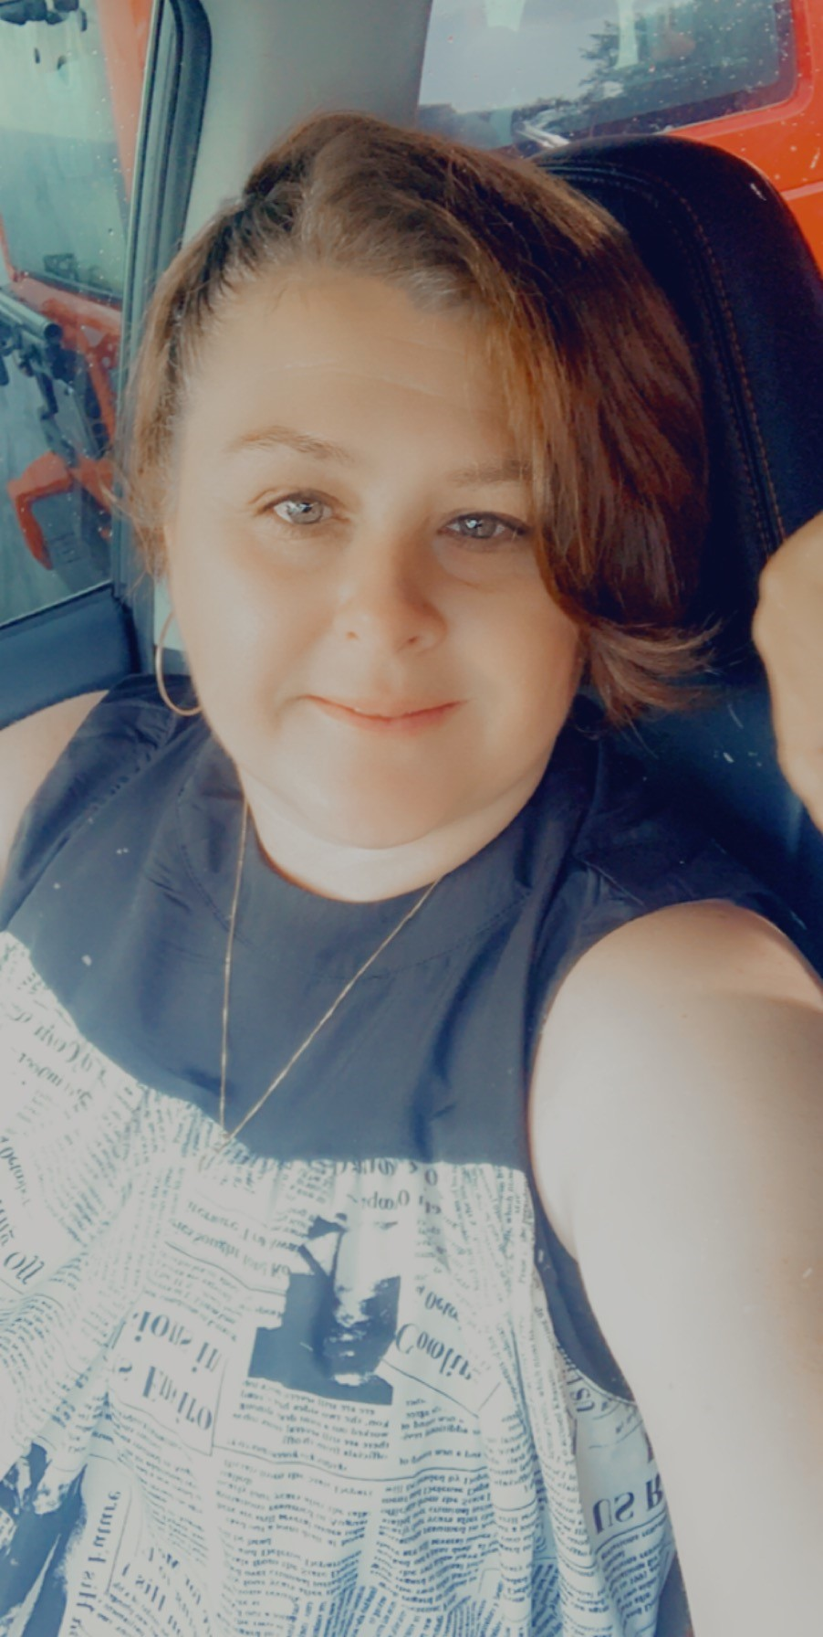
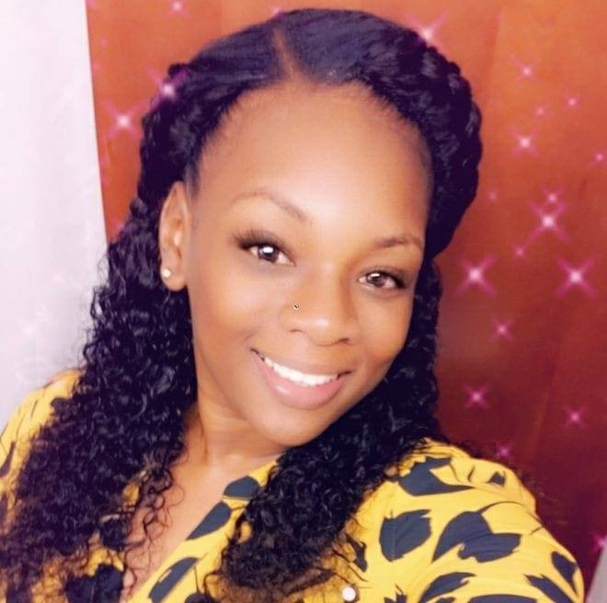
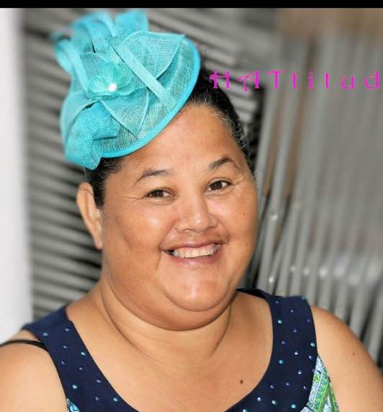
Vi-EHDI Program
The Virgin Island Early Hearing Detection and Intervention program is housed under the Maternal Child Health (MCH) Program umbrella. We are responsible for the hearing screening of all newborn babies' territory wide. Our program consist of the Program Coordinator and two (2) Family Care Coordinators.
Monique Bramble Family Care Coordinator St. Thomas
Ana Browne Family Care Coordinator St. Croix
Dawn Petersen Program Coordinator
Notes:
2020

Slide 62
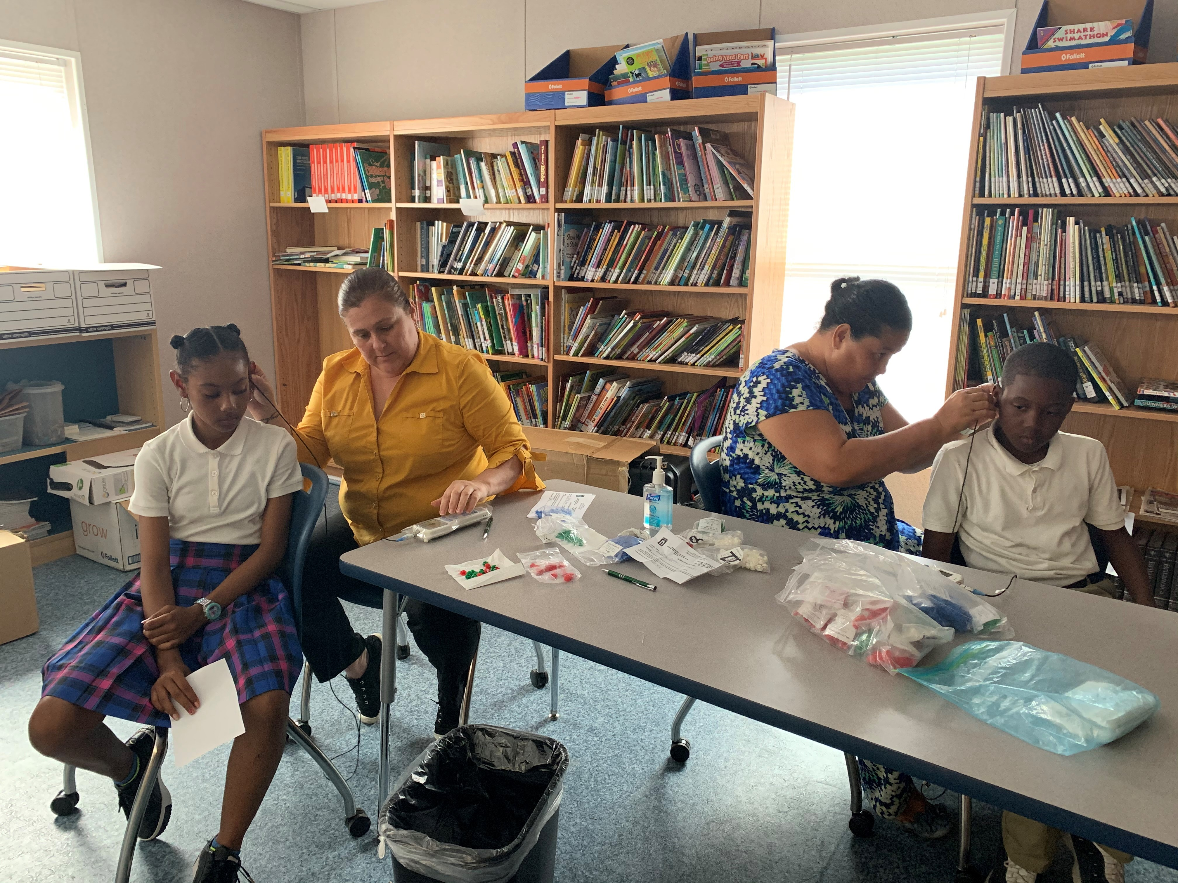
More about VI-EHDI
The VI EHDI also conduct
Hearing Screening for Early Headstart.
Annual Elementary School hearing Screening Initiative to all kindergarten and 6th grade territory wide.
Hearing Screening to transition children out of the Birth to Three Program.
Notes:
2020

Slide 63
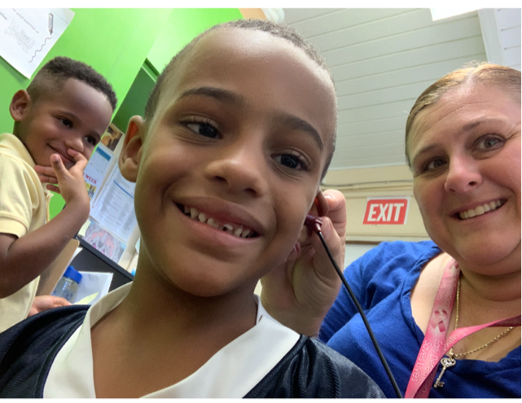
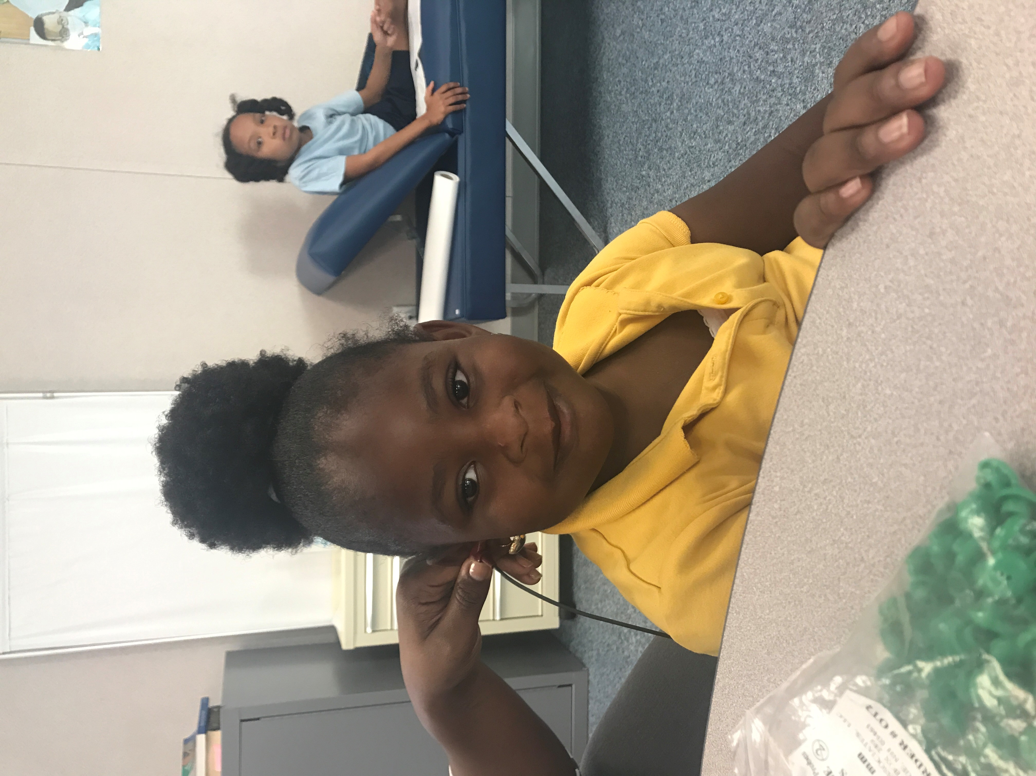
More about us
We collaborate with
  All MCH Programs (NFP, HFA, and Project Launch)
  Human Services
  Education
  Other VI Government Departments and Agencies
  VI Community Partners
  Federally Qualified Health Center
  Federal Partners
Notes:
2020

